Slide 1


Classification and Regression Trees (CART)
Notes:
Classification and Regression Trees or CART for short is a term to refer to Decision Tree algorithms that can be used for classification or regression predictive modeling problems. In this presentation, we introduce the key idea behind classification and regression trees and provide examples.

Slide 2
Decision Trees
Goal: Classify or predict an outcome based on a set of predictors
Output is a set of rules
Example:
Goal: classify a record as “will accept credit card offer” or “will not accept”
Rule might be “IF (Income > 92.5k) AND (Family < 3) THEN Class = 0 (non-acceptor)
Also called CART, Decision Trees, or just Trees
Rules are represented by tree diagrams
Notes:
So when we are considering decision trees, depending on whether we are using it for classification or regression, we are expecting the outcome of the tree to be either a numerical prediction for regression, or class prediction for classification problems. In any case, the output will be defined using a set of rules. Let’s consider an example. Imagine that we want to classify record as whether an applicant will accept a credit card offer or not. In that case, a rule might look like if income is greater than 92.5k, and family is smaller than three, then class is equal to zero. A decision tree is nothing but a combination of such rules. Decision trees are also referred to as cart, or decision trees, or just simply trees. Normally rules are represented by three diagrams for easier interpretation.

Slide 3
Key Ideas
Recursive partitioning: Repeatedly split the records into two parts so as to achieve maximum homogeneity within the new parts
Pruning the tree: Simplify the tree by pruning peripheral branches to avoid overfitting
Notes:
Decision trees can be implemented based on two key ideas, recursive partitioning and pruning of the tree. Recursive partitioning refers to repeatedly splitting each of the records into parts that are non-overlapping in order to maximize the purity of each part of the tree. We will explain this concept using examples in more details later on. Once a tree is constructed, we normally prune the tree and simplify the tree in order to avoid overfeeding. This means removing some of the unnecessary leaves and branches from the tree.

Slide 4
Recursive partitioning
Pick one of the predictor variables, xi
Pick a value of xi, say si, that divides the training data into two (not necessarily equal) portions
Measure how “pure” or homogeneous each of the resulting portions are
“Pure” = containing records of mostly one class
Algorithm tries different values of xi, and si to maximize purity in initial split
After you get a “maximum purity” split, repeat the process for a second split, and so on
Notes:
Here are some of the basic steps involved in recursive partitioning. So here we pick one of the predictor variables, xi, and then for these variables xi, we decide a value or threshold, si, that can be used to divide the training data into two parts. Note that these two portions, or two parts may not be necessarily of equal size. Then, we will measure how pure is the split. In this context, if we are considering classification, purity means that each of the partitions consists of mostly one class. If we are considering regression, purity refers to the standard deviation of the value within one partition. Ideally, we want the values within each partition to be as close to each other as possible. The algorithm evaluates different variables and different values of the si to maximize the purity in the split. So, in other words, we consider the split for all variables and for different values of the si, or threshold values, for each variable. After we get the initial maximum purity, we repeat the same process exactly the same in order to get the second split and so on.

Slide 5
Example: Riding Mowers
Goal: Classify 24 households as owning or not owning riding mowers
Predictors = Income, Lot Size
Notes:
Let’s consider a super simple example in here. In this example, we want to classify the households who own a riding mower. The data set consists of 24 households and we have the income and lot size for each of the households as well as the ownership status. Obviously for the households that own a bigger house and have a higher salary, there’s a higher chance of owning a mower.

Slide 6
How to split
Order records according to one variable, say lot size
Find midpoints between successive values
E.g. first midpoint is 14.4 (halfway between 14.0 and 14.8)
Divide records into those with lotsize > 14.4 and those < 14.4
After evaluating that split, try the next one, which is 15.4 (halfway between 14.8 and 16.0)
Notes:
So the first question is how to display the variables, so consider the previous example. Now imagine that we consider lot size as a variable to split. How can we split the data set based on the lot size? An easy way to do so is to find all the midpoints between successive values. So, we sort all of the values and we calculate the mid values between each successive value. In the previous example, the first midpoint would be 14.4 which is the halfway point between 14 and 14.8. Now we can divide the record into those lot sizes which are greater than this particular threshold and those which are smaller than this threshold. So, after evaluating this split, we try the next split which will be at 15.4 which is the halfway between 14.8 and 16. So the only thing that is important in here is to understand exactly how we do the observation. Remember, we try to make partition as homogeneous as possible.

Slide 7
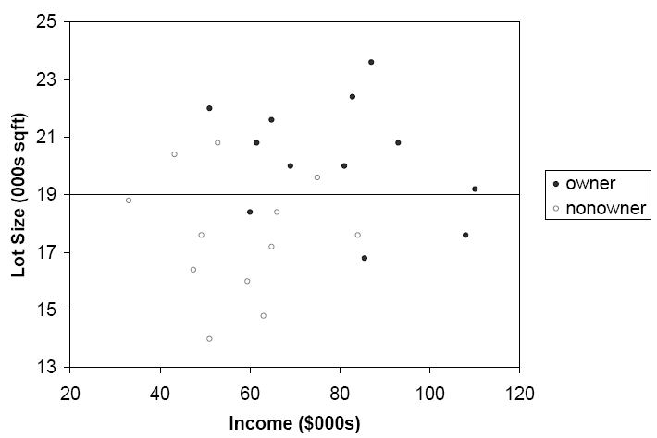
Example
Notes:
So here is an example of what the data would look like if we divide the data based on the lot size and we consider 19 as a threshold to decide the lot size. So, as you can see the purity of the partitions are not too bad. The lower partition consists of mostly non-owners and the upper partition consists mostly of the owners. Obviously, the goal is to make each partition as pure as possible, but it may not be possible to make it 100% pure.

Slide 8
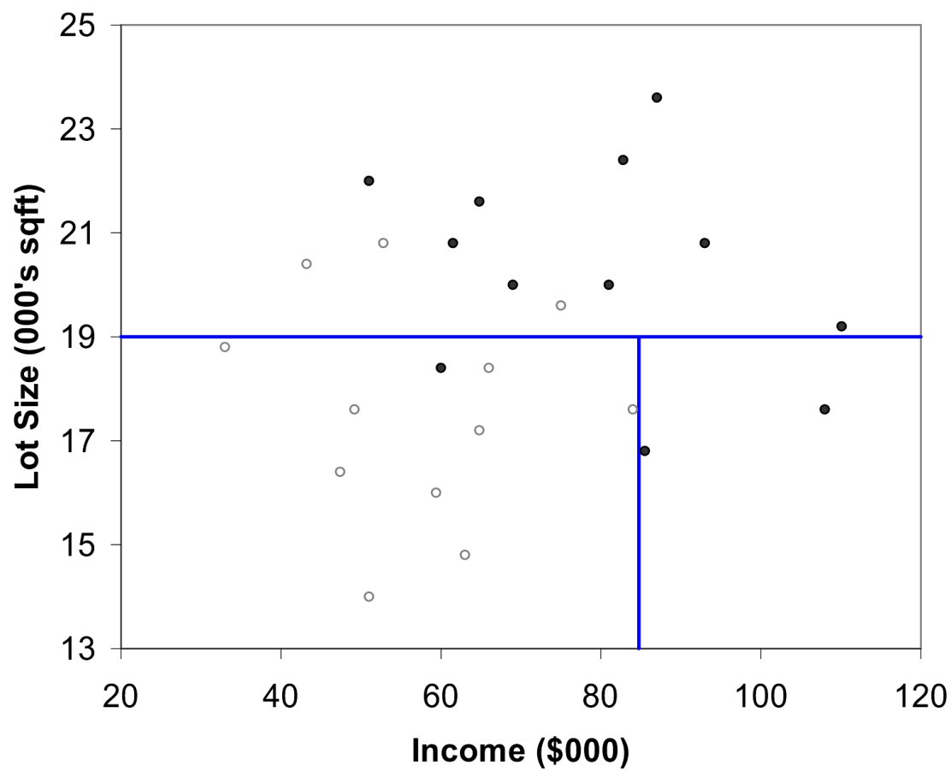
Example
Notes:
Now after the first split, the second split might be based on the income. In this case, as we can see, the split is shown around 84,000 dollars, as a vertical partition. So, as you can see, on the left lower side we have mostly non- owners, and on the right lower side we have two owners. Now imagine a more complex example where we have multiple variables which each of them may be partitioned several times. Another question is how do we decide which variable to partition first, and what are the optimal threshold values for partitions.

Slide 9
Gini Index
Gini Index for rectangle A containing m records
p = proportion of cases in rectangle A that belong to class k
I(A) = 0 when all cases belong to same class
Max value when all classes are equally represented (= 0.50 in binary case)
Notes:
As you might have noticed, we require metrics to be able to judge the purity of the partitions. Gini Index and entropy are two common metrics that are used for this purpose. Let’s start with the Gini Index. For partition A, which contains m different records, the Gini Index is defined as one minus the sum of the pk power two. Where pk is the proportion of the cases that belong to class k. Obviously the Gini Index is equal to zero when all cases belong to the same class. In this case we would have 100% purity in a partition. The maximum value of the Gini index would be the case when all classes are equally represented.

Slide 10
Entropy
p = proportion of cases (out of m) in rectangle A that belong to class k
Entropy ranges between 0 (most pure) and log2(m) (equal representation of classes)

Slide 11
Impurity and Recursive Partitioning
Obtain overall impurity measure (weighted avg. of individual rectangles)
At each successive stage, compare this measure across all possible splits in all variables
Choose the split that reduces impurity the most
Chosen split points become nodes on the tree
Notes:
So here are the steps involved in building a decision tree based on recursive partitioning and using impurity metrics. So first of all, we need to obtain an overall impurity measure, which is the weighted average of individual partitions, when dividing the data into various partitions. At each successive step, we compare this measure across all possible splits at each successive stage we compare this measure across all possible splits on all variables and using differentials on each particular value. We choose the split that reduces the impurity the most. The chosen splits that become a node on the tree moving forward and we repeat the process again.

Slide 12
Determining Leaf Node Label
For classification, each leaf node label is determined by “voting” of the records within it, and by the cutoff value
Default cutoff=0.5 means that the leaf node’s label is the majority class.
For regression, the mean values of records is used.
Notes:
Once a decision tree is done with the splitting, it requires determining the labels for each of the leaves. For classification, each leaf node or a terminal node label is determined by working of the labels within the partition. In other words, the majority would define what would be the class for that particular partition. For regression on the other hand, we use the mean value of all the records to define the output corresponding to that partition.

Slide 13
Example
Owner
Owner
Non-owner
Notes:
Lets’ consider an example again. In this case we have three partitions. The top partition would be labeled as owner because majority of the data points in that partition are owner. On the lower left-hand side on the other hand, the label would be non-owner because the majority of the data points are non-owners. Similarly, the last partition would be considered as owner because we have only two owner data points in that partition.

